Slide 1


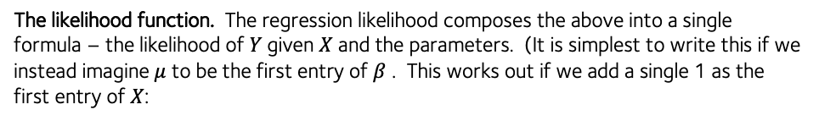







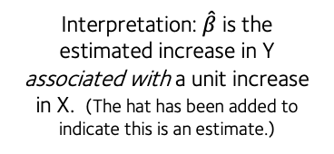








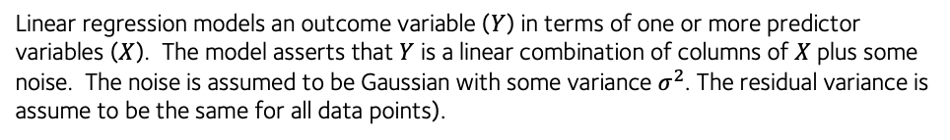


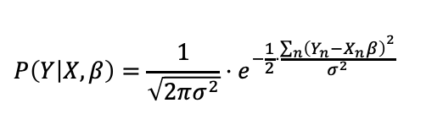
Linear regression cheatsheet
Gavin Band, WHG GMS Programme 2021
Linear regression models an outcome variable ($Y$) in terms of one or more predictor variables ($X$). The model asserts that $Y$ is a linear combination of columns of $X$ plus some noise. The noise is assumed to be Gaussian with some variance $σ^{2}$. The residual variance is assume to be the same for all data points).
Basic linear regression (maximum likelihood) in R:
> fit = lm( Y ~ X, data = D )
> coefficients(fit)
(Intercept) X
0.0007606242 0.3135072376
> logLik(fit)
'log Lik.' -132.981 (df=3)
> residuals(fit)
1 2 3 4
-0.6115976 -0.3239313 0.7034511 -0.2934937 . . .
> summary(fit)$coefficients
Estimate Std. Error t value Pr(>|t|)
(Intercept) 0.0007606242 0.09412669 0.008080856 0.9935689071
X 0.3135072376 0.08512788 3.682780013 0.0003778035
$$Y=μ+X_{1}β_{1}+X_{2}β_{2}+…X_{d}β_{d}+ε$$
$$ε\sim N(0,σ^{2})$$
Or using matrix notation:
$$Y=μ+Xβ+ε$$
$$ε\sim N(0,σ^{2})$$
Matrix multiplication of the d-dimensional row vector of predictors X and the d-dimensional column vector of of parameters $β$
“residual” error for this data point
Regression “slope” ($\hat{β}$)
This turns out to have an analytic solution:
Interpretation: $\hat{β}$ is the estimated increase in Y associated with a unit increase in X. (The hat has been added to indicate this is an estimate.)
$$\hat{β}= {\left(X^{t}X\right)}^{−1}X^{t}Y$$
Maximum likelihood estimate (MLE)
$$Y$$
$$\text{variance}\left(\hat{β}\right)=σ^{2}{\left(X^{t}X\right)}^{−1}$$
Variance of MLE
“intercept”
($μ$)
$$\text{se}\left(\hat{β_{j}}\right)= \sqrt{σ^{2}{{\left(X^{t}X\right)}_{jj}}^{−1}}$$
Standard error of MLE
$$0$$
$$1$$
$$2$$
$$3$$
$$4$$
But what if you want to fit with prior information included? Use brms package:
$$X$$
> library( bmrs )
> fit = brm(
Y ~ X,
data = data,
prior = set_prior( “normal(0,1)” )
)
> fit$fit
Inference for Stan model: ca2436c230608c2ca38ebc402110120d.
4 chains, each with iter=2000; warmup=1000; thin=1;
post-warmup draws per chain=1000, total post-warmup draws=4000.
mean se_mean sd 2.5% 25% 50% 75% 97.5% n_eff Rhat
b_Intercept 0.25 0.00 0.05 0.16 0.22 0.25 0.28 0.34 3549 1
b_X -0.05 0.00 0.04 -0.13 -0.08 -0.05 -0.02 0.03 4293 1
sigma 0.45 0.00 0.03 0.39 0.42 0.44 0.47 0.51 3729 1
lp__ -65.24 0.03 1.25 -68.44 -65.82 -64.91 -64.32 -63.81 1972 1
Samples were drawn using NUTS(diag_e) at Thu Nov 11 17:56:07 2021.
For each parameter, n_eff is a crude measure of effective sample size,
and Rhat is the potential scale reduction factor on split chains (at
convergence, Rhat=1).
The likelihood function. The regression likelihood composes the above into a single formula – the likelihood of $Y$given $X$ and the parameters. (It is simplest to write this if we instead imagine $μ$ to be the first entry of $β$ . This works out if we add a single 1 as the first entry of $X$:
For a single sample:
$$P\left(Y | X,β\right)=\frac{1}{\sqrt{2πσ^{2}}}⋅e^{−\frac{1}{2}⋅\frac{{\left(Y−Xβ\right)}^{2}}{σ^{2}}}$$
Squared residual (distance) from regression line
The outcome values are assumed independent of each other (probabilities multiply). So for multiple samples the likelihood is:
$$P\left(Y | X,β\right)=\frac{1}{\sqrt{2πσ^{2}}}⋅e^{−\frac{1}{2}⋅\frac{{\sum_{n}{\left(Y_{n}−X_{n}β\right)}}^{2}}{σ^{2}}}$$
“sum of squared errors”
For multiple samples:
($n=1,…,N)$
The exponent is negative. Maximising the likelihood is therefore the same as minimizing the sum of squared errors – it finds the ‘best-fitting line’.

